Slide 1
Lecture: 8 Food Safety, Security And Safe Health Nutrition in Bangladesh and developing countries
DR. Afrin Ahmed Clara (AfC) Senior lecturer, DEPARTMENT OF PUBLIC HEALTH SCHOOL OF HEALTH AND LIFE SCIENCE NORTH SOUTH UNIVERSITY

Slide 2
Food safety
Food Safety refers to handling, preparing and storing food in a way to best reduce the risk of individuals becoming sick from foodborne illnesses
The principles of food safety aim to prevent food from becoming contaminated and causing food poisoning

Slide 3
Food safety
Food Safety refers to handling, preparing and storing food (from farm to fork) in a way to best reduce the risk individuals becoming sick from foodborne illnesses (e.g. diarrhea, cholera, typhoid, hepatitis)
Lack of food safety or “unsafe food” affects 1 in 10 people every year and children are the worst sufferer because it initiates a vicious cycle between infection and malnutrition
Among the factors that affect the safety of our food, contamination and adulteration are of prime importance

Slide 4
It is a comprehensive approach that ensure food quality “from farm to fork”
Lack of food safety, i.e. food and waterborne disease kills 2.2 million people worldwide every year, 87% of them are children
Food safety can be jeopardized through food contamination or food adulteration

Slide 5
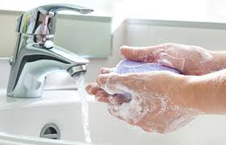
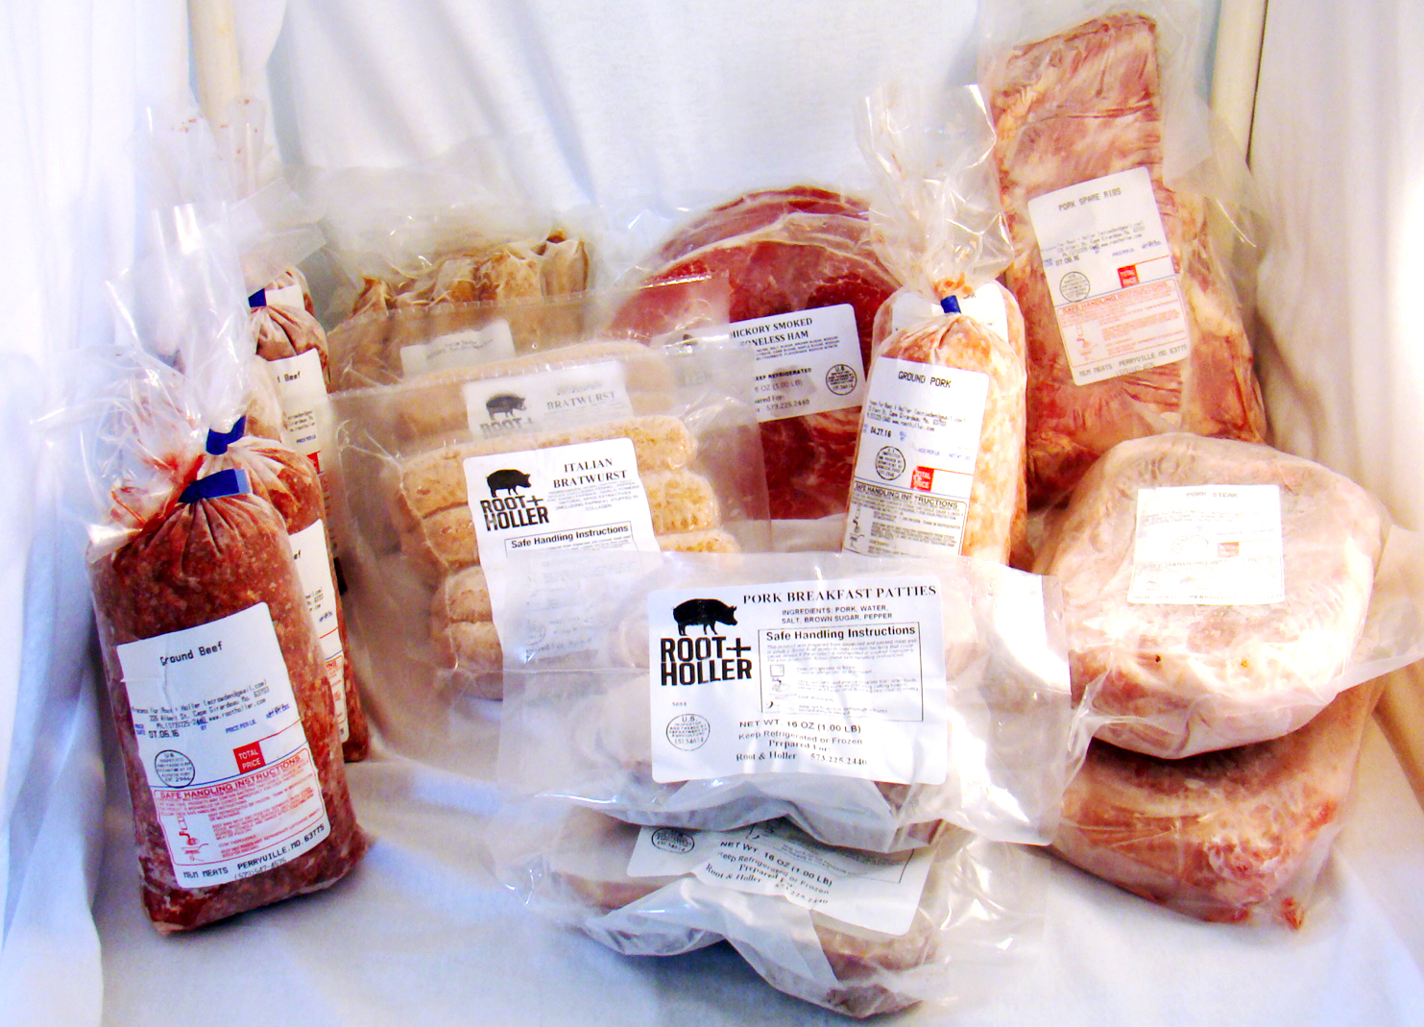
The WHO five keys to safer food
Keep Clean
Wash yours hands and all surfaces that come into contact with food
2. Separate raw and cooked food
keep raw meat, poultry and seafood separate from other foods

Slide 6

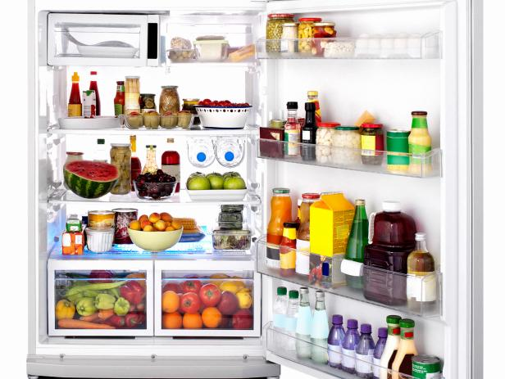
3. Cooked food thoroughly
Cook food to 70◦C to kill most microorganism
4. Keep food at safe temperature
Avoid storing food between 5 and 60○C, especially at room temperature

Slide 7
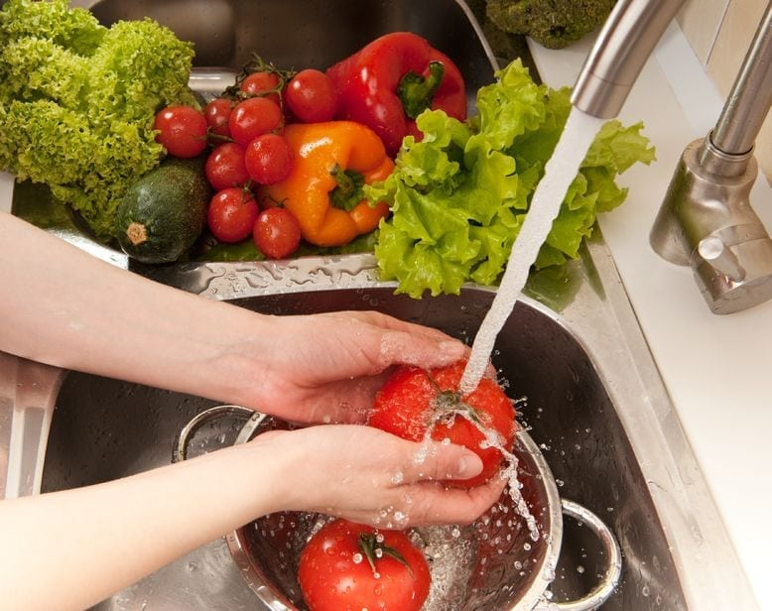
5. Use safe water and raw materials
Wash fruits and vegetables with safe water

Slide 8
Properly cleaning and sanitising all surfaces, equipment and utensils
Maintaining a high level of personal hygiene, especially hand-washing
Storing, chilling and heating food correctly with regards to temperature, environment and equipment
Implementing effective pest control
Comprehending food allergies, food poisoning and food intolerance

Slide 9
Food contamination
Food contamination can be defined as the presence of harmful chemicals and microorganisms in food, which can cause a variety of illness in consumers. These contaminants can be
agrochemicals
environmental contaminants
pesticides and carcinogens
processing contaminants
emerging food contaminants etc [perfluorinated compounds (PFCs), polybrominated diphenyl ethers (PBDEs), and nanomaterials; the pharmaceutical residues antibiotics and coccidiostats; and emerging groups of marine biotoxins]

Slide 10
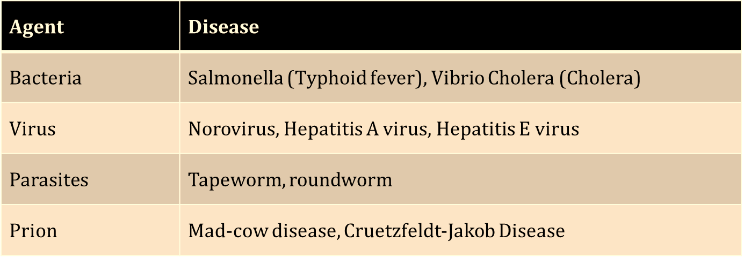
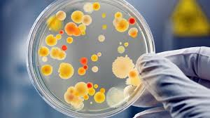
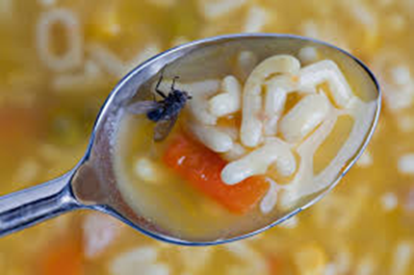

Biological contaminations
Biological contamination is when bacteria or toxins contaminate food and is a common cause of food poisoning and food spoilage

Slide 11
Food contamination
Biological Contamination • Refers to food that is contaminated by organisms or substances they produce • This includes biological matter produced by humans, rodents, insects and microorganisms • Bacteria and viruses are typically the two biggest causes of biological contamination and can result in some of the most common types of food poisoning including salmonella, E.coli, listeria and Norovirus

Slide 12

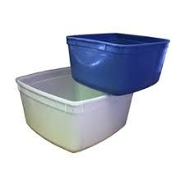
Chemical Contamination
Chemical contamination occurs when food comes into contact with chemicals and can lead to chemical food poisoning
Kitchen cleaning agents
pesticides and fungicides
Food containers made from non-safe plastics
Pest control products
Chemicals used in equipment maintenance

Slide 13

Physical Contamination
Physical contamination happens when actual objects contaminate foods
Hair
Glass or metal
Pests
Dirt
Fingernails

Slide 14
How food become contaminated
Leaving food uncovered
Touching parts of body while handling food
Sneezing or coughing near food
Licking finger while preparing food
Not washing hand after going toilet while preparing food
Poor handling of high risk food

Slide 15
Prevention of food contamination
Wash | Wash your hands before handling food, after going to the toilet. Wash and sanitize all Wash surfaces and equipment used for food preparation
Separate | Separate raw and cooked food, use separate equipment and utensils such as knives and cutting boards for handling raw foods and store separate containers for raw and prepared food
Cook | Cook food thoroughly, especially meat, poultry, eggs and seafood. Bring foods to boiling to make sure that they have reached 70°C. Reheat cooked food thoroughly

Slide 16
Prevention of food contamination
Keep food at safe temperatures, do not leave cooked food for more than 2 hours. Refrigerate promptly (preferably below 5°C).Keep cooked food piping hot (more than 60°C) prior to serving
Use safe water(or treat it to make it safe) and raw materials. Choose foods processed for safety, such as pasteurized milk. Wash fruits and vegetables, especially if eaten raw. Do not use food beyond its expiry date

Slide 17
Unsafe food and children
Children are considered as the worst sufferers from unsafe food and foodborne illness as it initiates a vicious cycle of infection and malnutrition One third of the deaths from foodborne illnesses are among children under the age of 5 years.

Slide 18
Unsafe food and children
As estimate shows 220 million foodborne illness cases develop among children under the age of 5 years and 96,000 of them die due to these illnesses Children also suffer more frequently from serious complications of foodborne illnesses, i.e. Hemolytic Uremic Syndrome (HUS) in case of E. coli O157 (15% among children compared to 6% among general population)

Slide 19
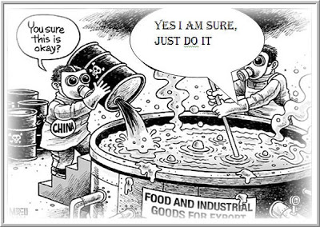
Food Adulteration
Food Adulteration refers to the process by which the quality or the nature of a given food is reduced through addition of adulterants or removal of vital substance
Basically, during food adulteration, small quantity of non-nutritious substances are added intentionally to improve the appearance, texture or storage properties of the food

Slide 20
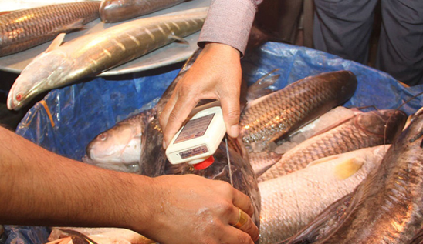
The widespread use of formalin, in preservation of fish, fruit and other food items is posing a threat to public health. The chemical used as a solution in water keeps fish fresh and makes fruits like mangoes attractive. This chemical, usually used to stop dead bodies from rotting, is now being used to preserve edible items

Slide 21
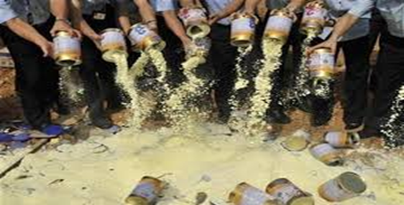

In 2008, Chinese food safety officials have seized 64 tonnes of raw dairy materials (infant formula) contaminated with the toxic industrial chemical melamine after 54,000 babies were hospitalized and 6 died from kidney stones.

Slide 22
CAUSES OF FOOD ADULTERATION
Profit motive of traders: Done as a part of the business strategy
Food insecurity: To increase quantity of food production and sales.
Increased Urbanization: To make maximum profit from food items by fewer investments.
High population demands: Increased food demand of the population and its changing trends.

Slide 23
CAUSES OF FOOD ADULTERATION
Illiteracy of general public: Lack of consciousness of proper food consumption.
Lack of effective food laws
Lack of government in initiative

Slide 24
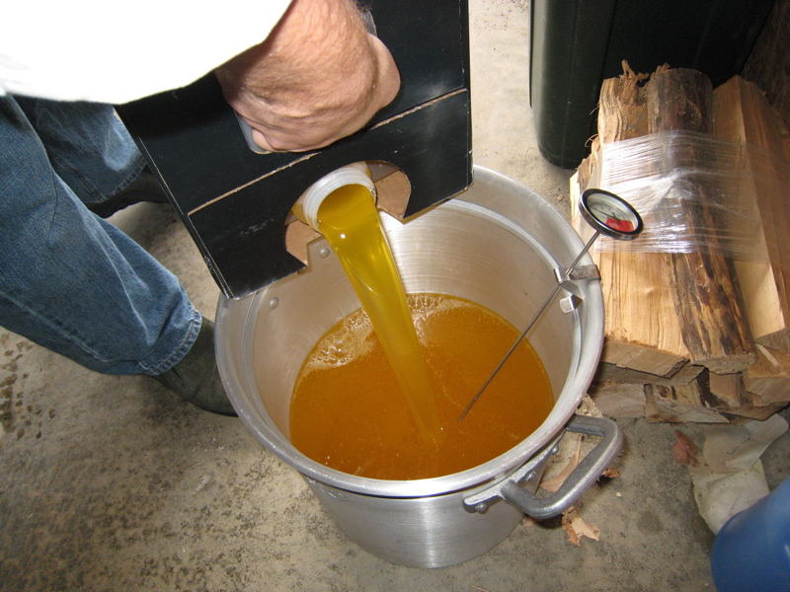
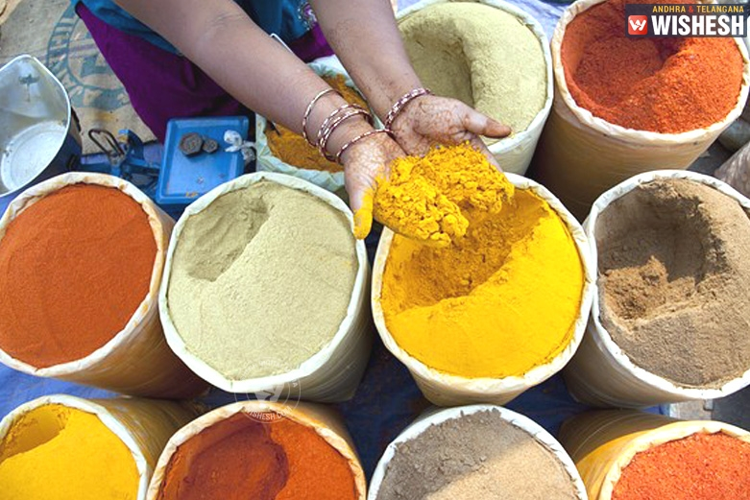
HEALTH HAZARDS OF FOOD ADULTERATION
Mineral oil if added to edible oil and fats can cause cancers.
Lead chromate when added to turmeric powder and spices can cause anaemia, paralysis, brain damage and abortions.

Slide 25
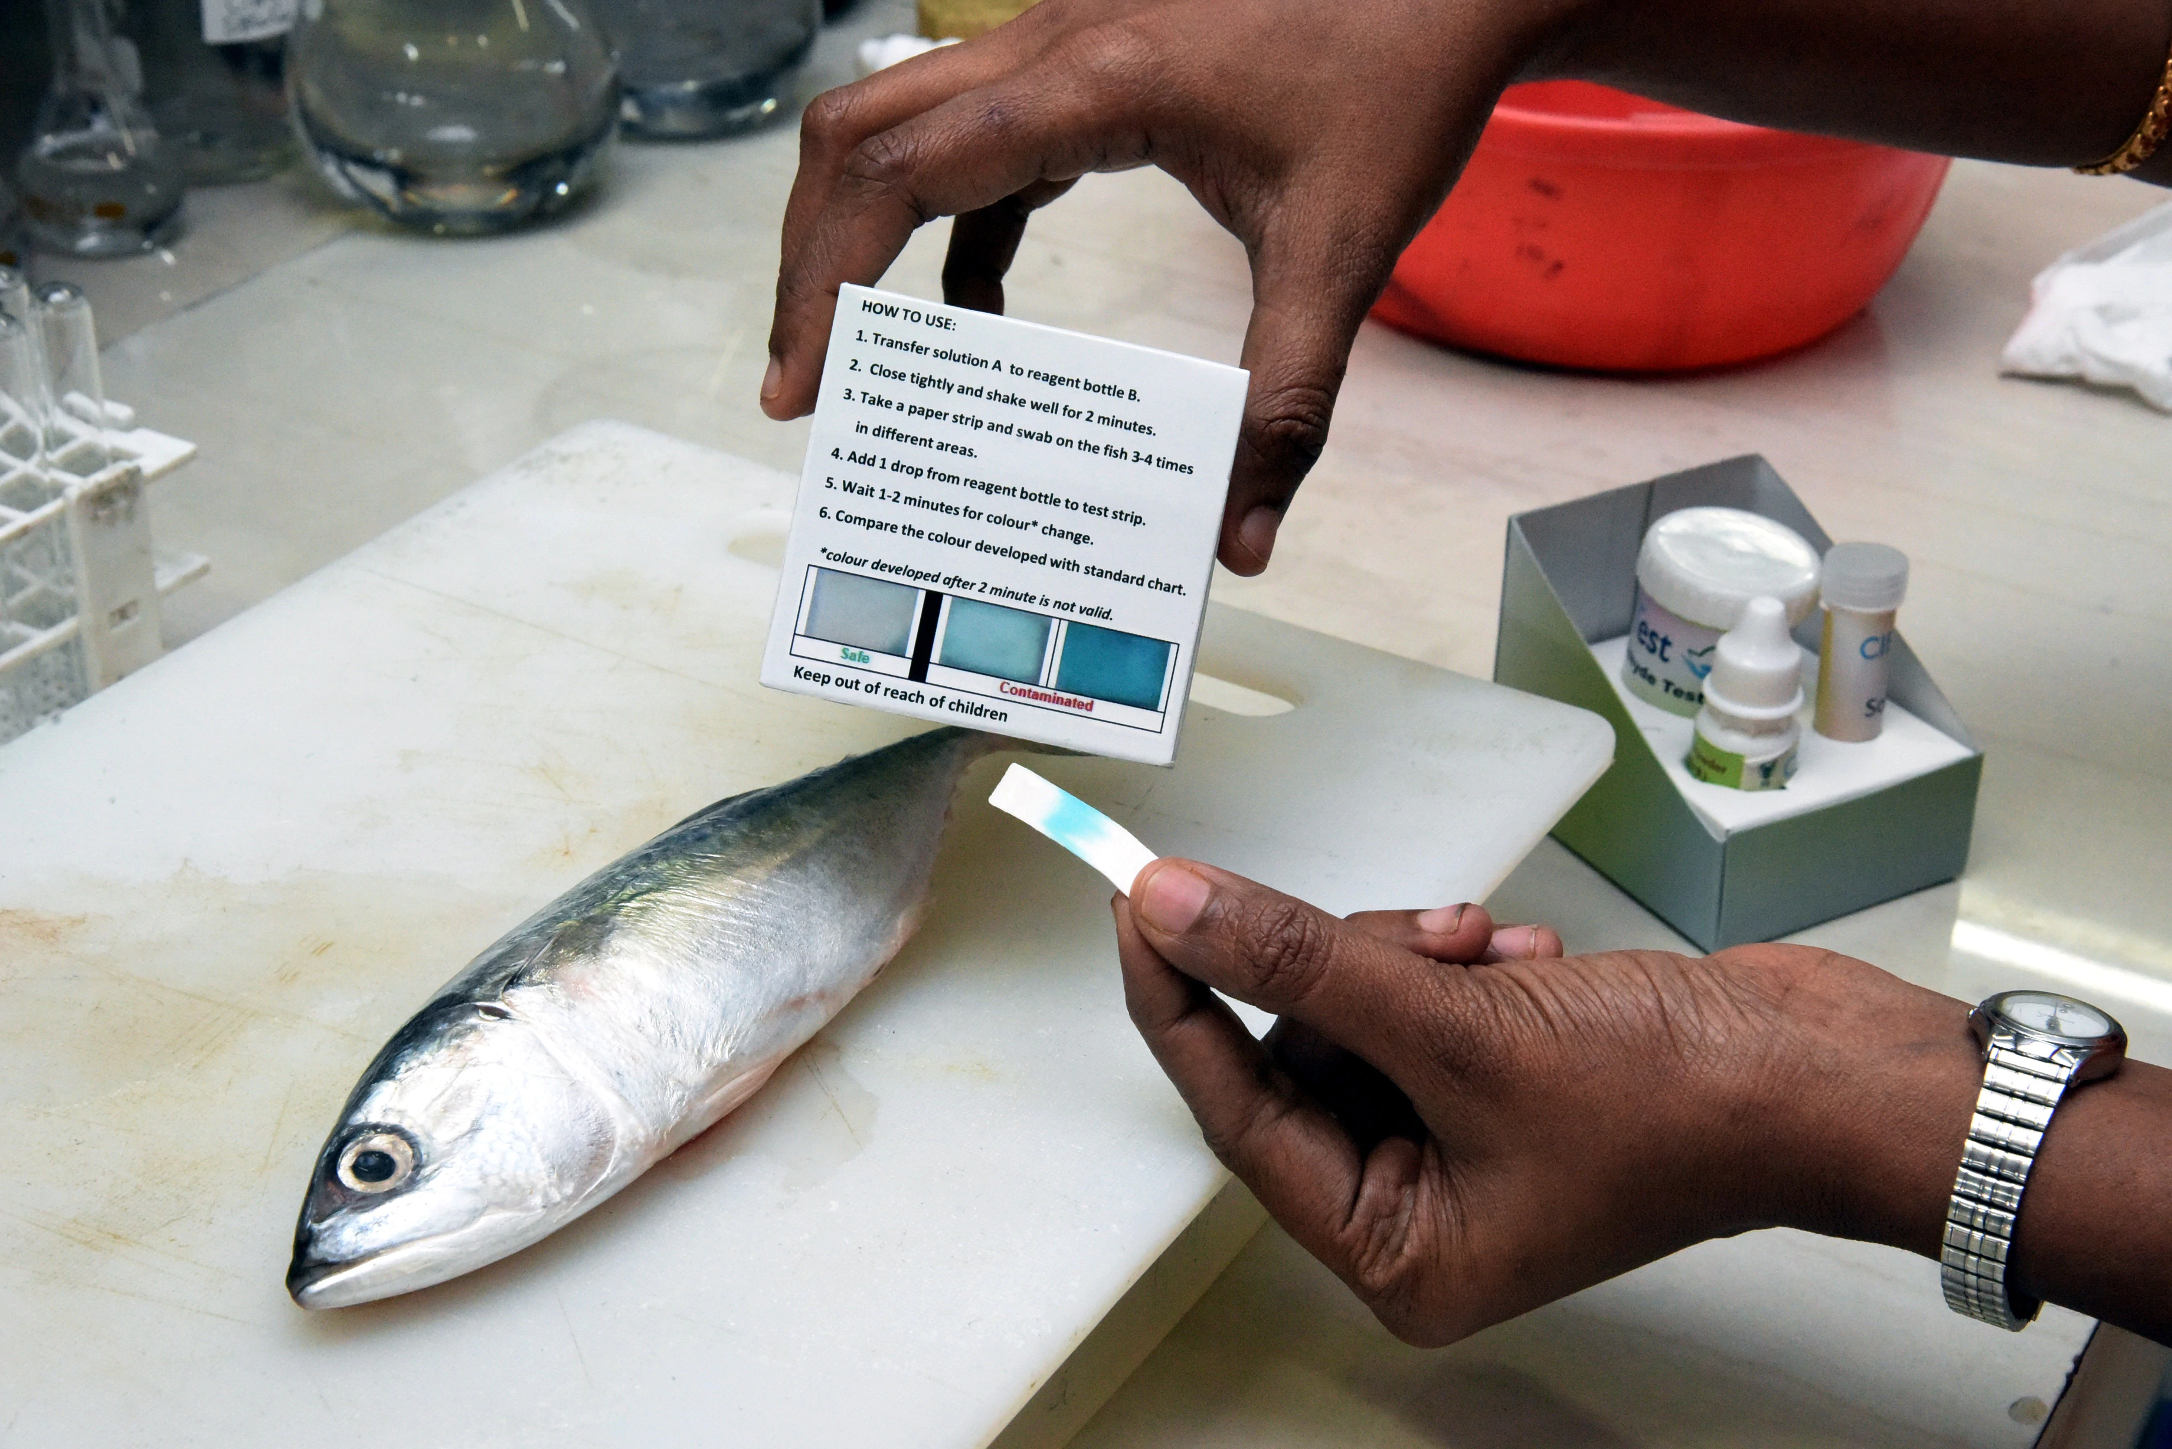
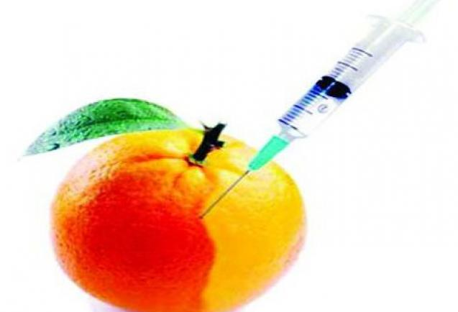
Mercury in mercury fungicide treated grains, or mercury-contaminated fish can cause brain damage, paralysis, and death.
Non-permitted colour or permitted food colour like metal yellow, beyond the safe limit in coloured food can cause allergies, hyperactivity, liver damage, infertility, anaemia, cancer and birth defects.

Slide 26
Contamination vs Adulteration
Contamination | Adulteration
Food contamination happens when “something” (contaminant) gets into food that shouldn’t be there | Food Adulteration refers to the process by which the quality or the nature of a given food is reduced through addition of adulterants or removal of vital substance
Contaminant can be physical, chemical or Biological | Adulterants are non-nutritious or even harmful substances
Contamination is usually done unintentionally | Adulteration is done intentionally for more profit (by increasing shelf-life, increasing the weight or improving the texture of food items)
Examples of contaminants are hair, dust, pest or pest dripping (physical), heavy metal, non-food grade plastic, dishwasher, insecticide (chemical) bacteria, virus, prion, parasite (Biological) | Example of adulterants are carbide (to ripen fruit) formalin (to increase shelf-life), textile color (to make vegetable more attractive), stone-chips (to increase weight of rice or other grains)

Slide 27
Effect of contamination and adulteration
Contamination
▶ Food borne disease(cholera, typhoid, hepatitis, food poisoning). Often these diseases are characterized by:
▶ Abdominal cramps
▶ Nausea
▶ Vomiting
▶ Diarrhea – dehydration
▶ Fever
▶ Allergic reactions
▶ Poisoning from chemical substances, e.g. Mercury

Slide 28
Effect of contamination and adulteration
Adulteration
▶ Acute problems like food poisoning
▶ Long term use can cause problems in heart, liver, kidney, stomach and cancers in different parts of the body
▶ Chronic consumption of non-nutritious adulterants can lead to malnutrition, especially in children.

Slide 29
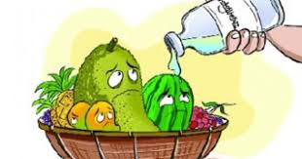
Food additives
Non-nutritive substance added intentionally to food, generally in small quantities to improve appearance, flavour, texture or storage properties. Amounts used in food are usually regulated by law

Slide 30

MITIGATION MEASURES FOR ADDRESSING FOOD ADULTERATION
There must be proper surveillance of the implementation food laws.
There should be monitoring of the activities with periodical records of hazards regarding food adulteration.
There should be periodical training programmes for Senior Officer/Inspector/Analysts for food safety

Slide 31
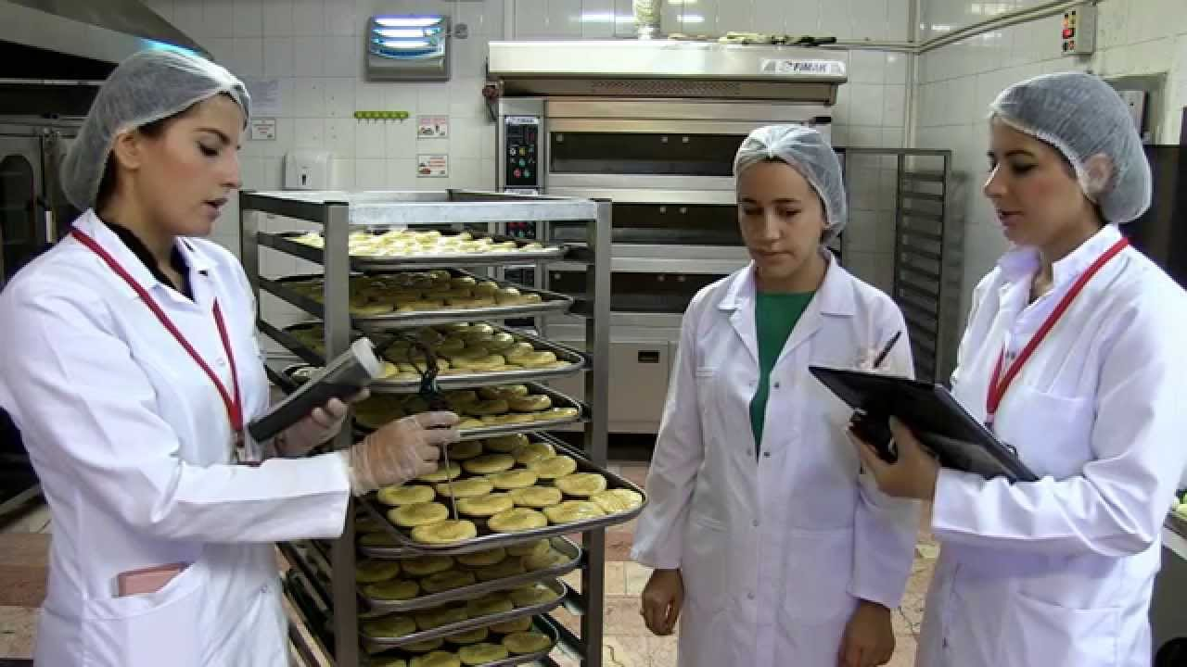
There should be consumer awareness programs organized by holding exhibitions/seminars/training programs and publishing pamphlets.
There should be strict actions regarding the punishment for those who are involved in food adulteration.
There should be help and support from International INGOs for implementation of food laws.

Slide 32
Adulterants used in Bangladesh
Carbide – to ripen fruits like banana, mango, papaya
Formalin – to preserve fish, fruits and vegetable, milk
Textile color - applied on raw vegetables or cooked food for coloring, brightness, and freshness
Urea – Used in puffed rice or rice for whiteness
Coloring agents - used in spices, sauces, and juices, lentil, and oils to make them attractive

Slide 33
Adulterants used in Bangladesh
Agino moto or monosodium glutamate (tasting salt) – used in chinese and other food items to increase taste
Brick powder, saw dust – used in Chilly powder to increase weight
Chalk powder – used in milk, sugar to increase thickness and weight respectively

Slide 34
Food Security
Food security exists when all people, at all times, have physical and economic access to sufficient, safe and nutritious food to meet their dietary needs and food preferences for an active and healthy life (FAO)
Food security for a household means access by all members at all times to enough food for an active, healthy life. Food security includes at a minimum, (USDA)

Slide 35
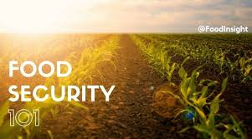
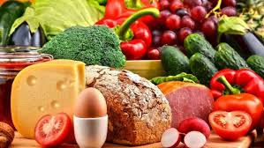

Slide 36
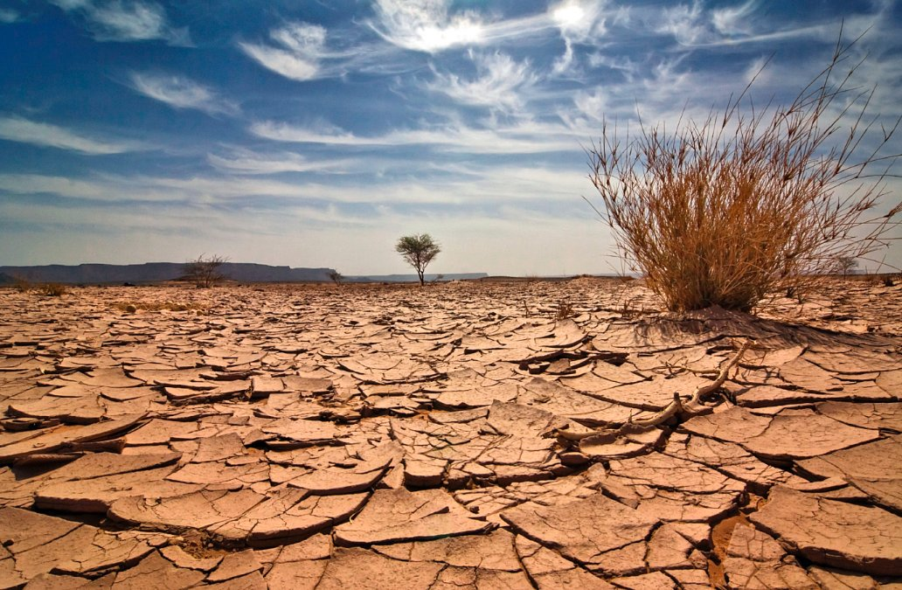
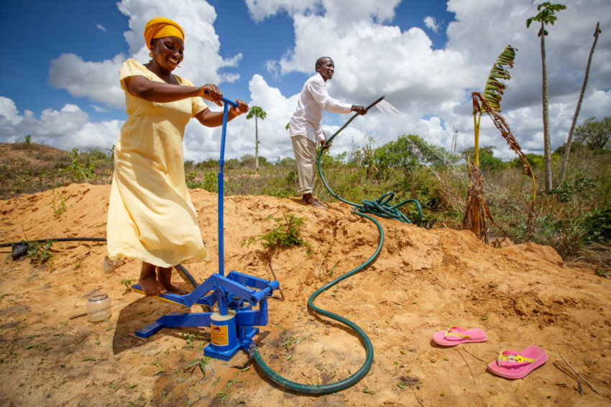
Things affecting food security today include
Global Water Crisis--Water table reserves are falling in many countries (including Northern China, the US, and India) due to widespread over-pumping and irrigation

Slide 37
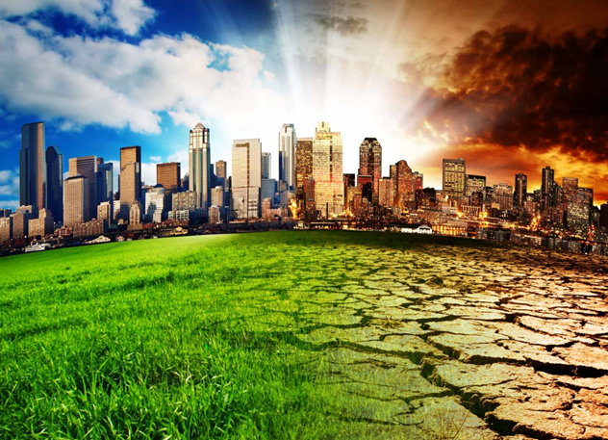
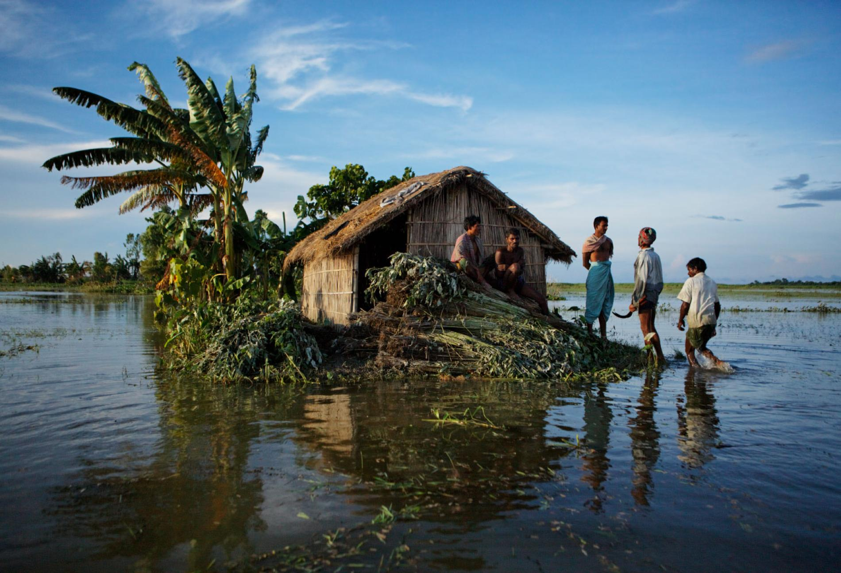
Climate Change--Rising global temperatures are beginning to have a ripple effect on crop yields, forest resources, water supplies and altering the balance of nature

Slide 38
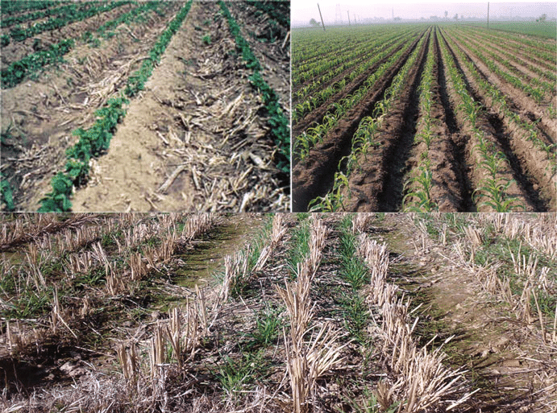
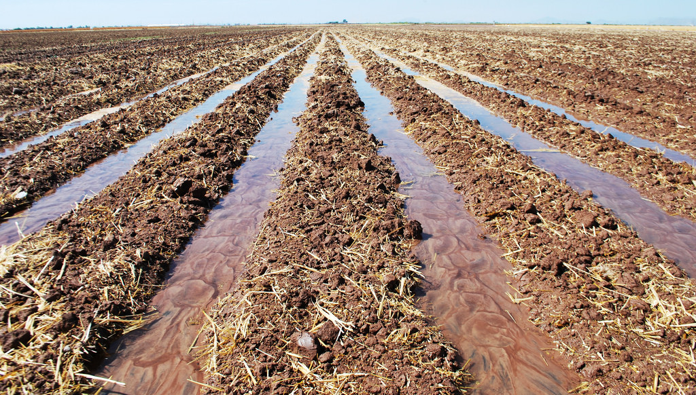
Land Degradation--Intensive farming leads to a vicious cycle of exhaustion of soil fertility and decline of agricultural yields

Slide 39


Greedy Land Deals--Corporations and Governments buying rights to millions of acres of agricultural land in developing countries to secure their own long-term food supplies

Slide 40
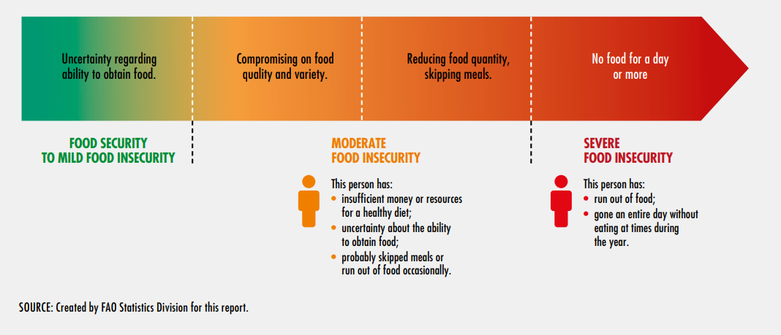
Stages and grades of food (in)security

Slide 41
Dimensions of Food Security
Availability: Physical availability of food from the “supply side” and is determined by the level of food production, stock levels and net trade
Accessibility: Economic and Physical access to food and determined by incomes, expenditure, markets and prices
Utilization: Biological aspect dealing with the way the body makes the most of various nutrients in the food which is determined by good feeding practices, food preparation, diversity of the diet and intra-household distribution of food.
Stability: Refers to the importance of availability and accessibility to food “at all times”
http://www.fao.org/3/al936e/al936e00.pdf

Slide 42
Food security metrics
Metric | Domain
Prevalence of undernourishment | Physical availability or access
Share of food expenditure by poor | Economic access
Relative dietary supply index | Physical availability or access
Domestic food price volatility | Economic access
GHI | Physical availability or access Nutritional status

Slide 43
Thank you

